Slide 1
Phase1 project: Movie Data Analysis
By: Cynthia Dalmas

Slide 2
PROJECT MAIN OBJECTIVE
For this project, We will use exploratory data analysis to generate insights for the Microsoft stakeholder who would like to venture in movie creation fun.
SPECIFIC OBJECTIVES
This project's value is in helping a this specific stakeholder solve a real-world problem by exploring the following insights.
1.Types of studios that are currently doing best in movie making.
2.Understanding the most produced genres that has better ratings and with more votes .
3.Identifying gross revenue for each top 10 genres to start with.
4. Preferred runtime for movies.
6. Trends and patterns in growth of movie creation industry.

Slide 3
DATA SOURCES
https://www.boxofficemojo.com/
https://www.imdb.com/
https://www.rottentomatoes.com/
https://www.themoviedb.org/
https://www.the-numbers.com/

Slide 4
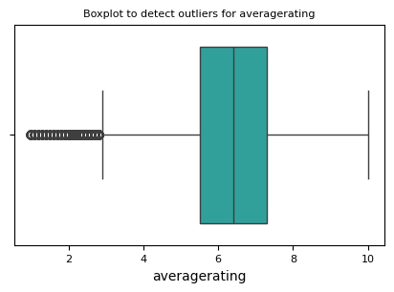

DISTRIBUTION OF VOTES AND RATINGS
There are ratings for some movie titles that were abnormal
There are number of votes for some movie titles that were abnormal

Slide 5

DISTRIBUTION OF DOMESTIC GROSS
There are some movie titles that gave abnormal domestic gross returns

Slide 6
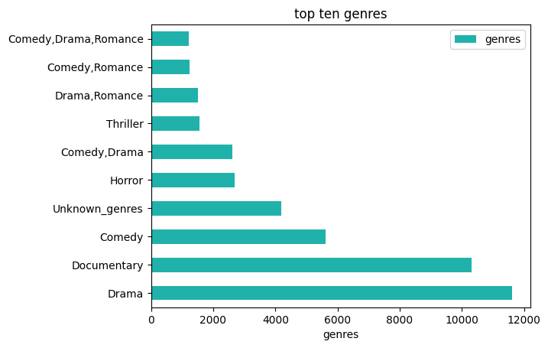
ANALYSIS OF LEADING GENRES
The leading genre in terms of movie titles produces is Drama, Documentary and comedy

Slide 7
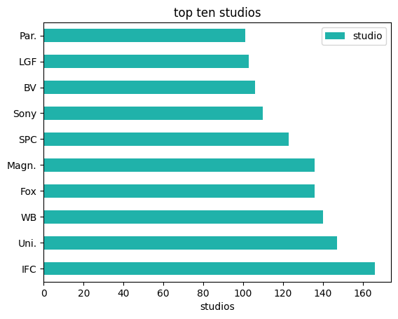
ANALYSIS OF LEADING STUDIOS
The leading studio in the moving production industry is IFC.
This makes it the Best studio to work with for launching movies.

Slide 8
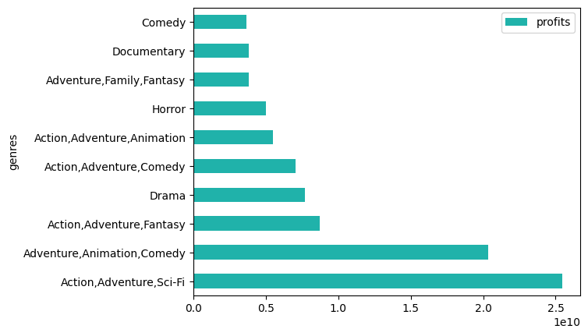
ANALYSIS OF LEADING GENRES WITH RESPECT TO PROFIT (Wordlwide gross –Production budget)
Action, Adventure,Sci-Fi gave good profits when we compare worldwide gross and production budget

Slide 9
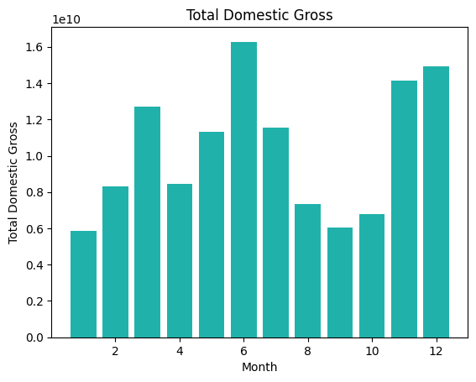
DOMESTIC GROSS VS RELEASE DATE GENERATION TREND BY MONTH
June is leading as the best month that had many releases hence high domestic gross.

Slide 10
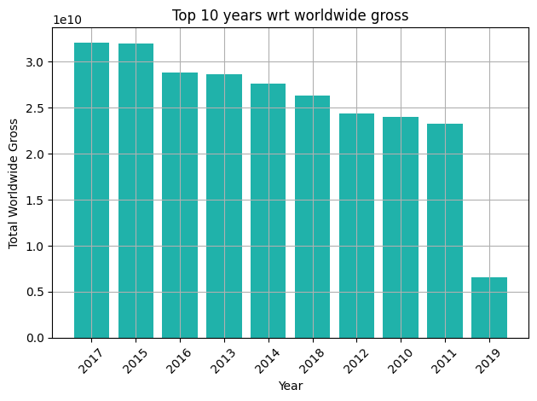
WORLDWIDE GROSS REVENUE TREND BY YEAR
Worldwide gross are high in 2017,2015 and very low in 2019 . This shows a decline in worldwide gross as time progresses.

Slide 11
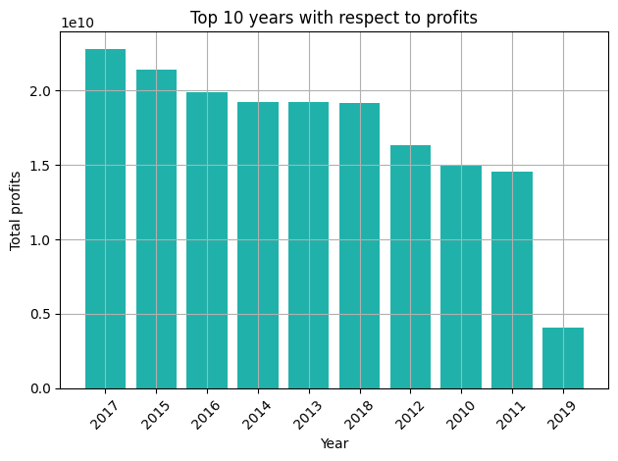
PROFIT TREND BY YEAR
Profits are high in 2017,2015 and very low in 2019 . This shows a relationship between worldwide gross and profits .
A decline in one affects the other.

Slide 12
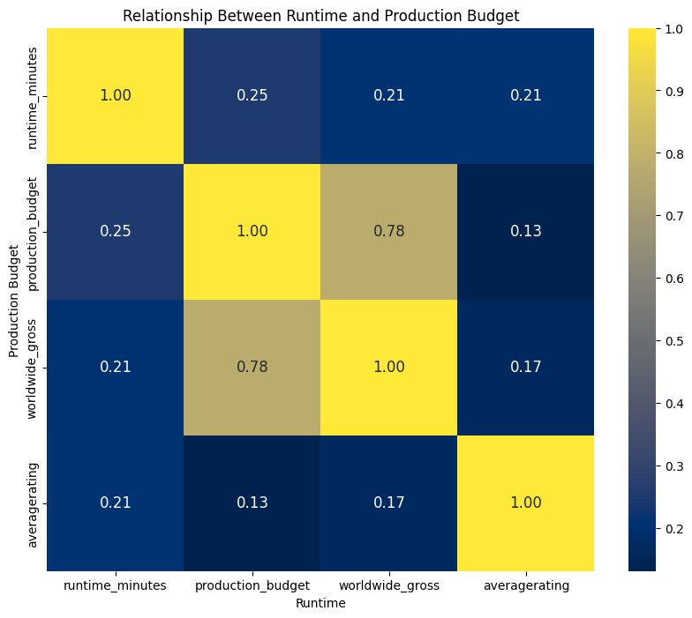
CORRELATION OF AVERAGE RATING,RUNTIME,NUMBER OF VOTES,PRODUCTION BUDGET,WORLDWIDE GROSS

Slide 13
CORRELATION CONTINUED….
There is a correlation between runtime minutes and production budget. Movies titles that run for longer minutes will cost high production budget.
There is a correlation between runtime minutes and worldwide gross. Movies titles that run for longer minutes will return high gross.
There is a correlation between runtime minutes and average rating. Movies titles that run for longer minutes will get good ratings
There is a correlation between production budget and worldwide gross. Movies titles that run for longer minutes have high budget return high worldwide gross.

Slide 14
FINDINGS
There is a correlation between a movie's runtime, average ratings and number of votes to its production budget
Action adventure and SCI-FI were the most profitable in revenue
Drama led in the most produced genres
IFC studio produced most movie titles

Slide 15
RECOMMENDATIONS
I would recommend the following to Microsoft stakeholders;
To consider venturing in movie production with genres like Action adventure ,SCI-FI and Drama
To launch their movies with IFC studios
To translate their movies to worldwide languages.
To observe festivals and months of the years with most holidays to release movies.

Slide 16
Thank you

